Slide 1
Exploring the Intersection: Obesity Trends and BikePoint Accessibility in London Boroughs
JDAC – G7 Data Scientist – Technical Exercise
Dr Vinotharan Annarasa
Aims & Objectives
Aim:
To create a MVP for selecting optimal sites for new BikePoints in London Boroughs, promoting cycling to combat obesity
Objectives:
Map current BikePoints
Chart obesity rates across London Boroughs and superimpose BikePoints
Create an interactive tool aiding decision-makers in pinpointing potential BikePoint locations
Notes:
Title
This presentation is titled Exploring the intersection: Obesity Trends and BikePoint Accessibility in London Boroughs.
The term BikePoints refer to cycling docking station.
Aims & Objectives
The aim of this presentation is to create a minimum viable product to enable decision makers, who wants to encourage people to exercise, to select optimal sites for new BikePoints.
There are several stages in developing the minimum viable product.
Step 1 is to understand the current BikePoint infrastructure across London.
The next step is to understand the prevalence of obesity across the London Boroughs.
Lastly, by combining the above, make an interactive tool to enable the decision maker to explore the data and make a suitable decision.

Slide 2
Exploring the Intersection: Obesity Trends and BikePoint Accessibility in London Boroughs
JDAC – G7 Data Scientist – Technical Exercise
Dr Vinotharan Annarasa
Aims & Objectives
Aim:
To create a MVP for selecting optimal sites for new BikePoints in London Boroughs, promoting cycling to combat obesity
Objectives:
Map current BikePoints
Chart obesity rates across London Boroughs and superimpose BikePoints
Create an interactive tool aiding decision-makers in pinpointing potential BikePoint locations
Overall Recommendations
Based on an evaluation of two scenarios for the expansion of the BikePoint network, the following boroughs are recommended for new BikePoints:
Barking and Dagenham
Croydon
Hounslow
Notes:
Recommendations
I explored two different scenarios when considering what recommendations to make. These scenarios will be explored in detail in the later slides. The recommendations outlined here are the intersection of the outcomes from both scenarios.
The recommendations are:
Barking and Dagenham
Croydon
Hounslow

Slide 3
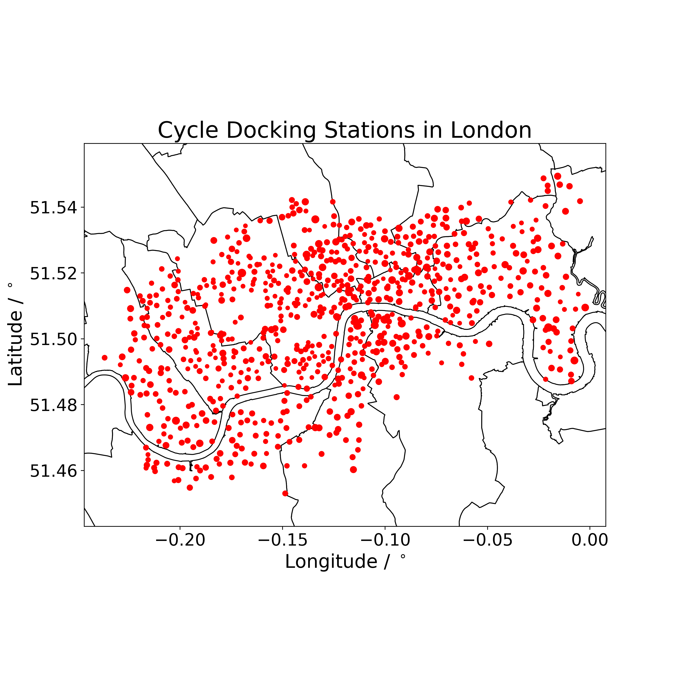
1. Map current BikePoints
= Number of BikePoints at the location
[1] TfL API: https://api-portal.tfl.gov.uk/api-details#api=BikePoint&operation=BikePoint_GetAll
Notes:
Map current BikePoints
Firstly, I wanted to understand the number of BikePoints in the various London Boroughs. For that I leverage the TfL API to extract the Longitude, Latitude and the number of BikePoints at that location.
Secondly, I downloaded Shape file for the London Boroughs such that I can plot the BikePoints on the map.
Although the size of the scatter points does reflect the number of BikePoints, due to the density of the BikePoints around some locations, it is difficult to see. Scaling this up any further will make the plot even more unreadable.

Slide 4
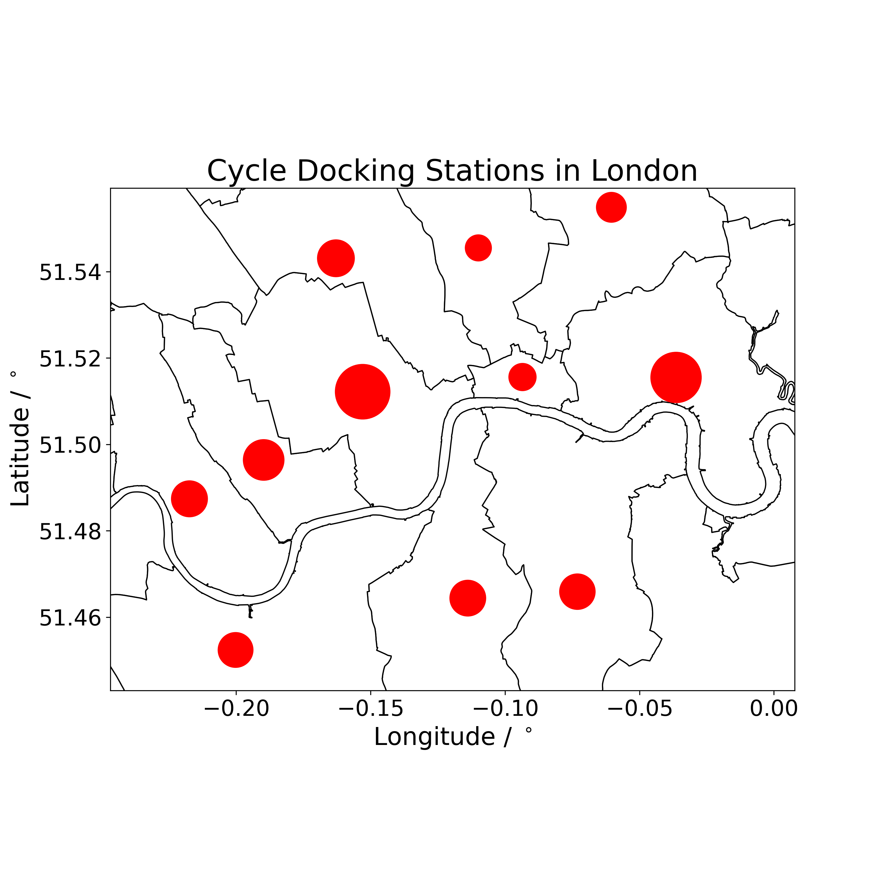
1. Map current BikePoints
= Number of BikePoints at the location
= Number of BikePoints at the Borough
[1] TfL API: https://api-portal.tfl.gov.uk/api-details#api=BikePoint&operation=BikePoint_GetAll
Notes:
This is why I created the image to the right. It is possible to see the number of BikePoints at each Borough more clearly now. The one disadvantage here is the boundaries of the the BikePoints are difficult to see.

Slide 5

1. Map current BikePoints
= Number of BikePoints at the location
= Number of BikePoints at the Borough
[1] TfL API: https://api-portal.tfl.gov.uk/api-details#api=BikePoint&operation=BikePoint_GetAll
Notes:
For example, let’s have a look at Hackney. It makes it look like the BikePoints are scattered throughout the brough when this is not the case!

Slide 6
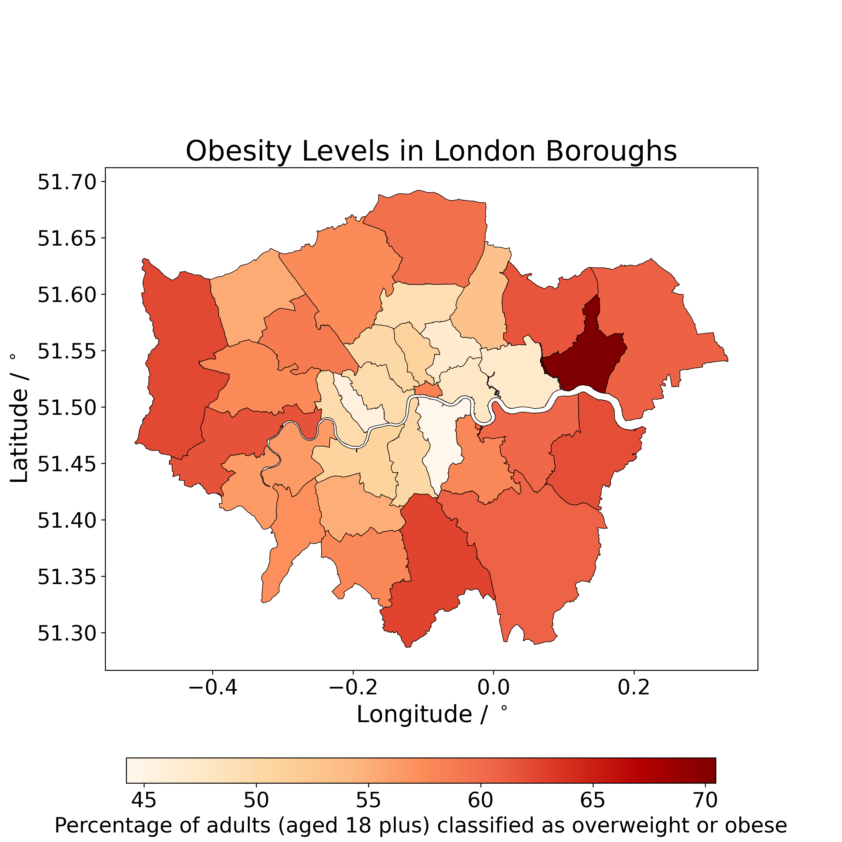
2. Chart obesity rates across London Boroughs and superimpose BikePoints
[2] Public Health England Obesity Profiles: https://fingertips.phe.org.uk/profile/national-child-measurement-programme/data#page/9/gid/1938133288/pat/402/par/E06000001/ati/3/are/E02002483/iid/93105/age/200/sex/4/cat/-1/ctp/-1/yrr/3/cid/4/tbm/1/page-options/car-do-0_car-ao-0
Notes:
Chart obesity rates across London Boroughs and superimpose BikePoints
The next step is to understand the prevalence of obesity across the London Boroughs.
To do so, I leveraged the Public Health England’s obesity profiles. This was easy to access as it was neatly packaged into the fingertips_py package.
The data I extracted was the obesity profiles for those aged 18 and over.
I leverage the shape file again and developed a choropleth map which illustrated the prevalence of obesity across the London boroughs.

Slide 7
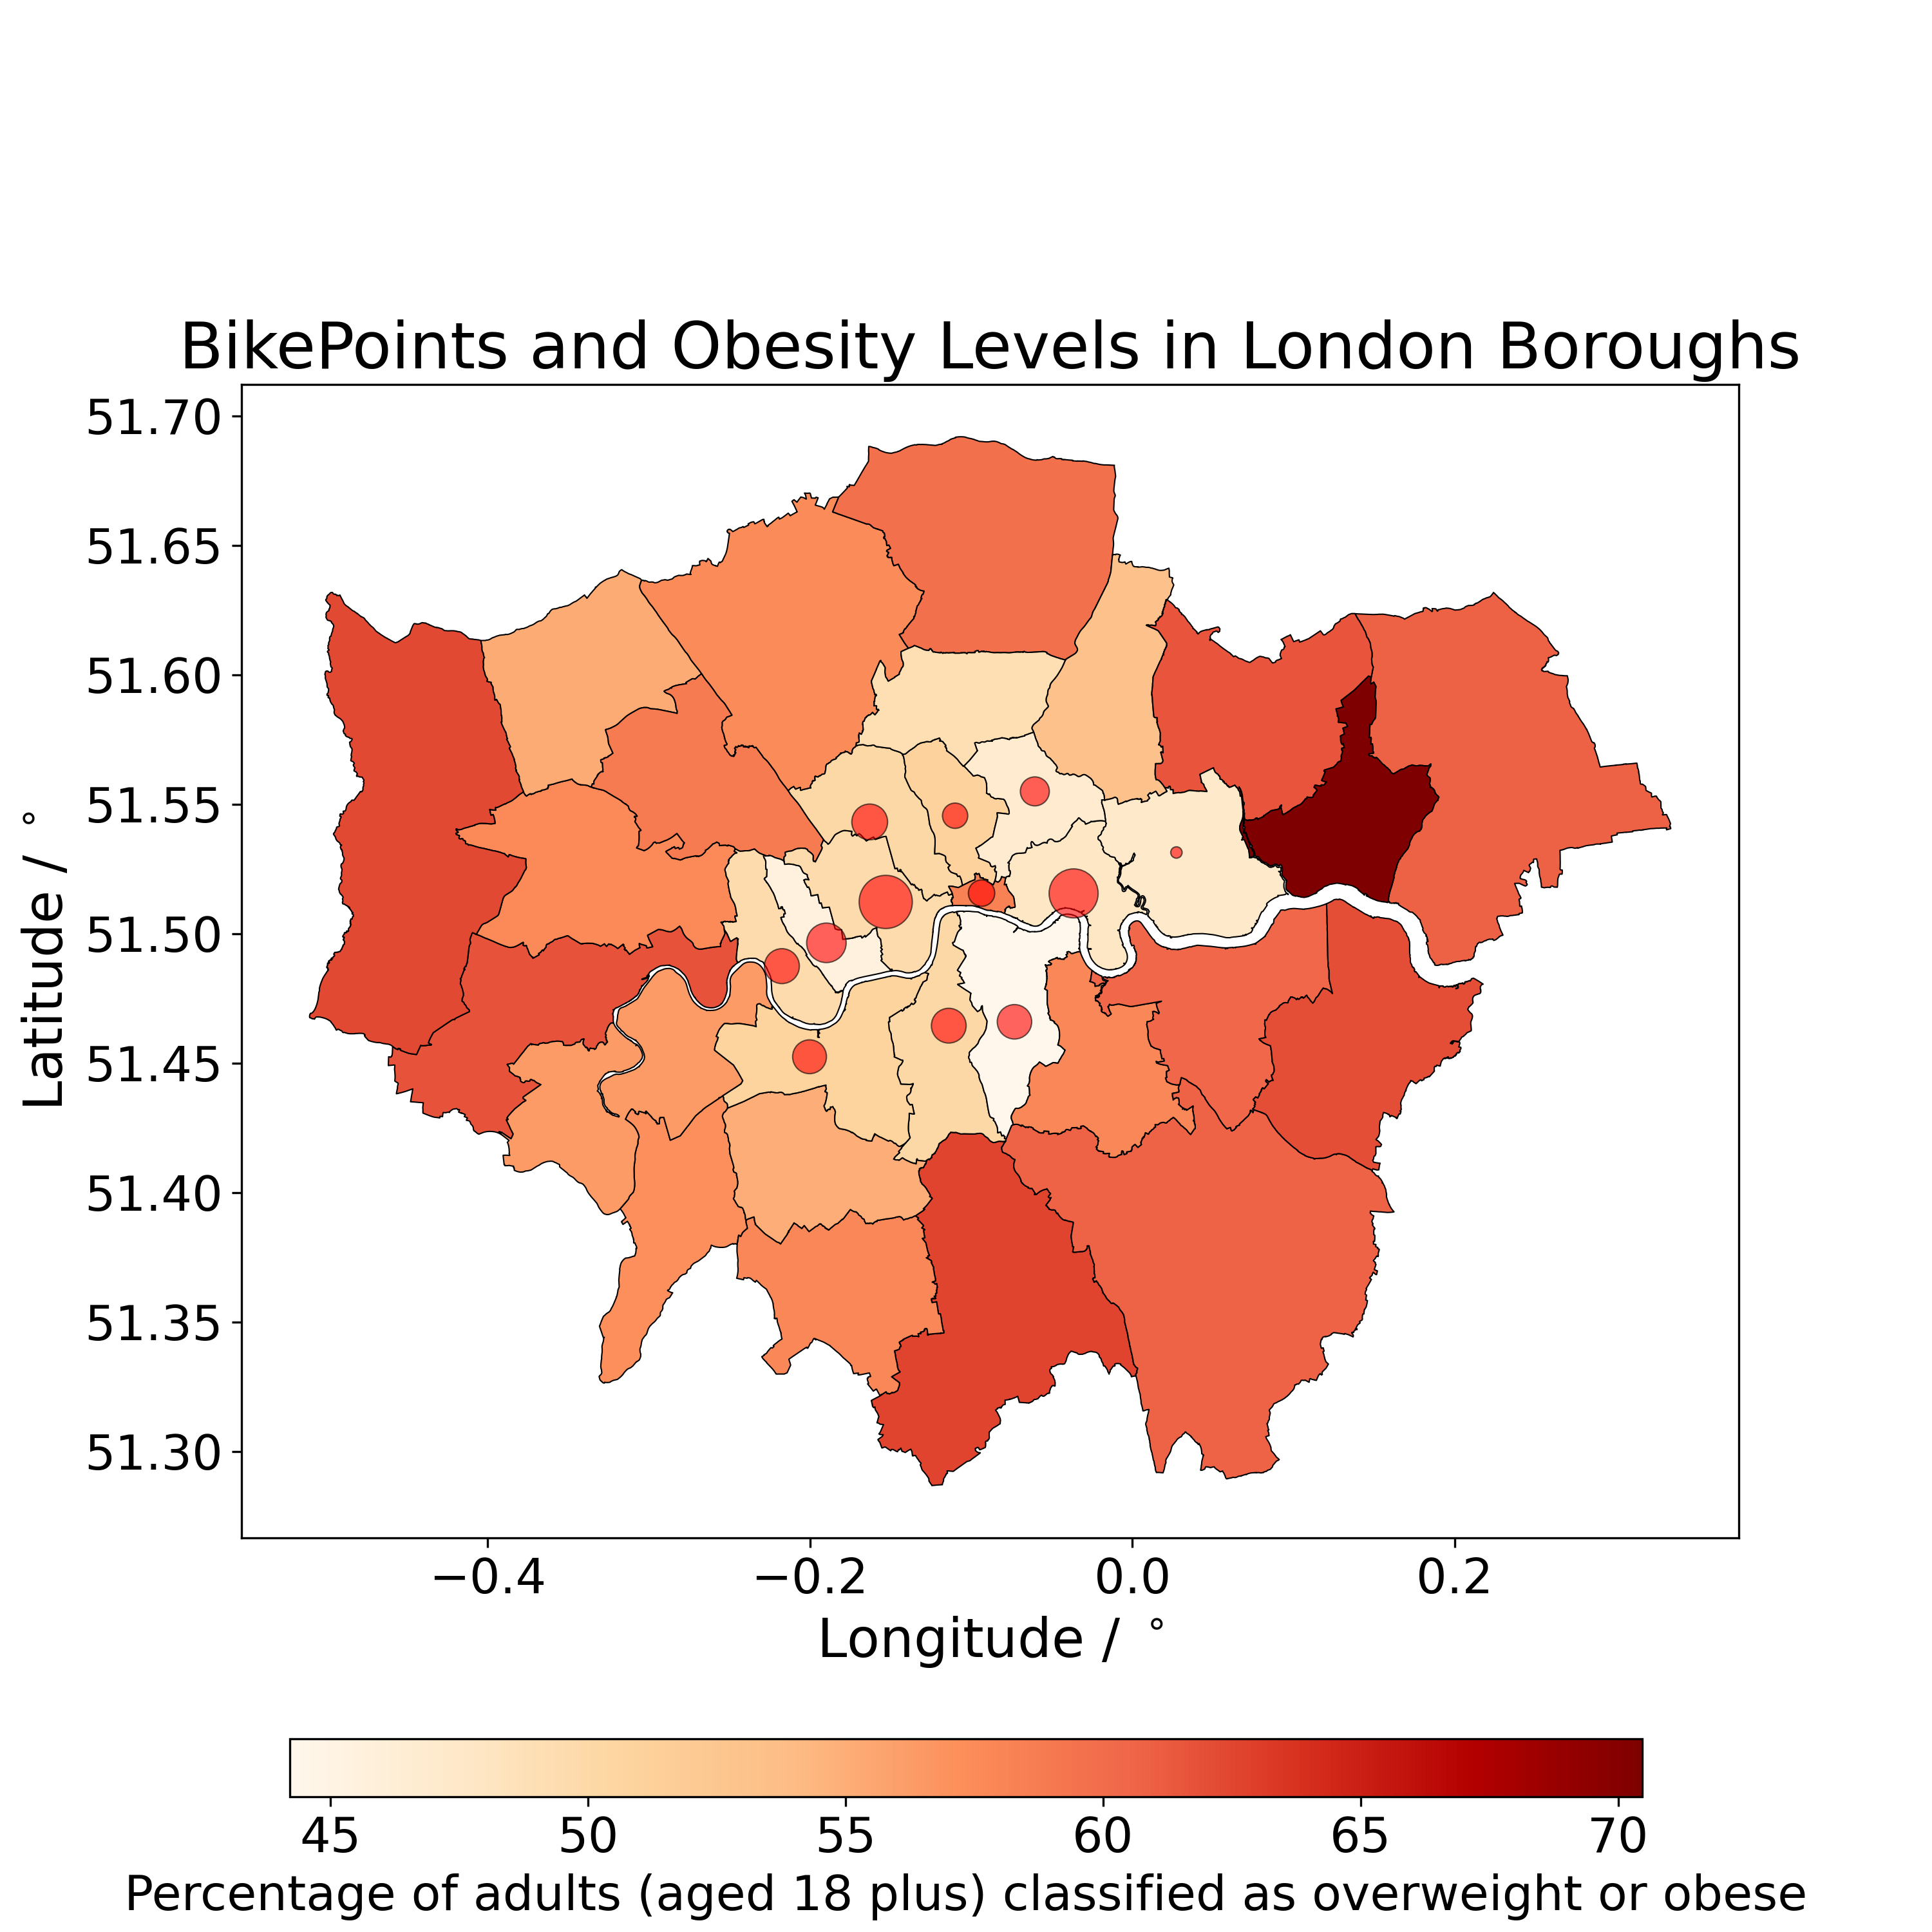
2. Chart obesity rates across London Boroughs and superimpose BikePoints
= Number of BikePoints at the Borough
[2] Public Health England Obesity Profiles: https://fingertips.phe.org.uk/profile/national-child-measurement-programme/data#page/9/gid/1938133288/pat/402/par/E06000001/ati/3/are/E02002483/iid/93105/age/200/sex/4/cat/-1/ctp/-1/yrr/3/cid/4/tbm/1/page-options/car-do-0_car-ao-0
Notes:
I then overlayed the scatter points that illustrate the BikePoints across London Boroughs. It is possible to now see areas that have a significant level of obesity, that do not have any BikePoints.

Slide 8

2. Chart obesity rates across London Boroughs and superimpose BikePoints
= Number of BikePoints at the Borough
[2] Public Health England Obesity Profiles: https://fingertips.phe.org.uk/profile/national-child-measurement-programme/data#page/9/gid/1938133288/pat/402/par/E06000001/ati/3/are/E02002483/iid/93105/age/200/sex/4/cat/-1/ctp/-1/yrr/3/cid/4/tbm/1/page-options/car-do-0_car-ao-0
Notes:
For example, Barking and Dagenham.
The difficulty here is that it is very hard to tell what the actual prevalence is when you have similar colour profiles. Hence the need for an interactive map.

Slide 9
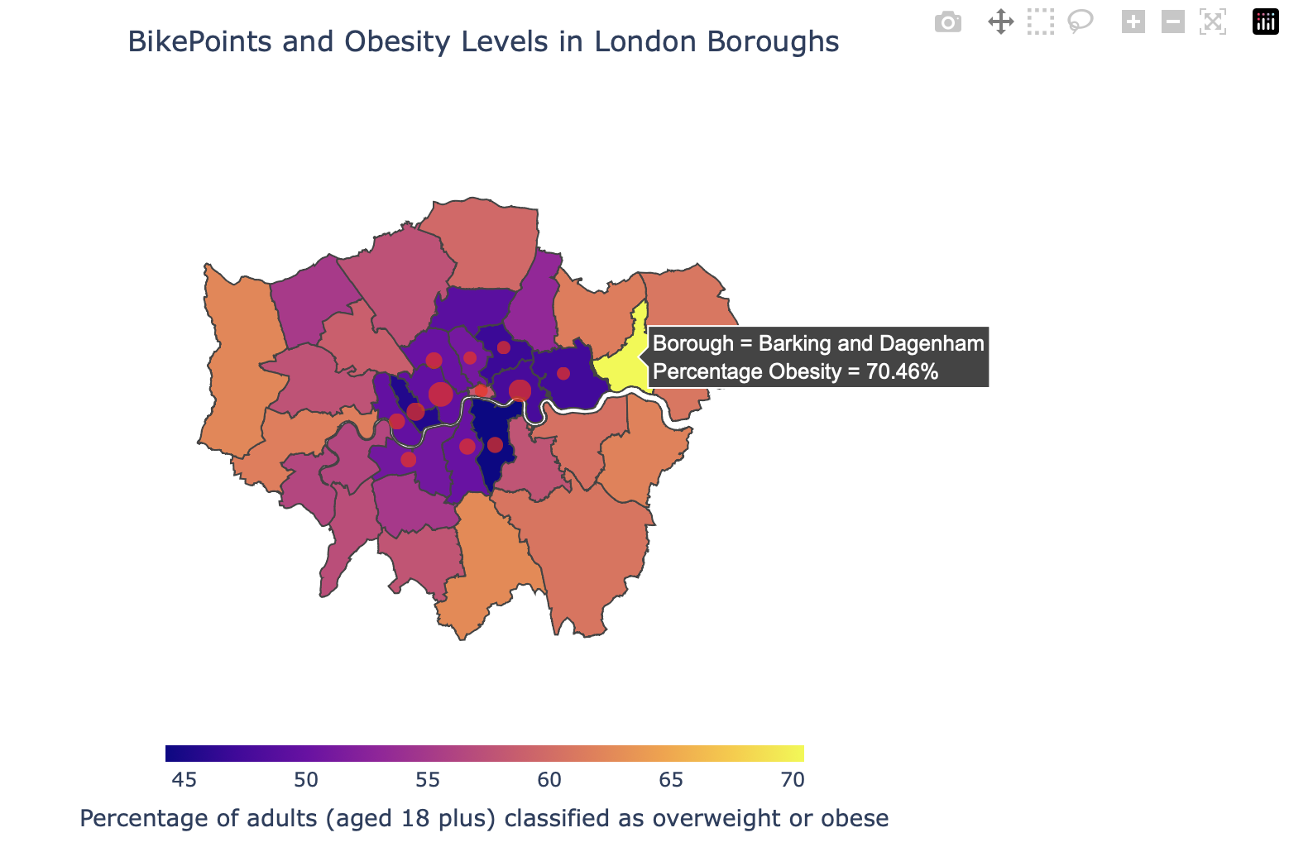
3. Interactive tool and recommendations
= Number of BikePoints at the Borough
Notes:
Interactive tool and recommendations
An interactive tool was developed using plotly dash. As you can see, by hovering over either the boroughs or the scatter points, you can extract useful information, such as the brough name and the percentage obesity values.

Slide 10
3. Interactive tool and recommendations
Scenario 1 (consider prevalence of obesity ONLY):
Barking and Dagenham
Croydon
Hillingdon
Bexley
Hounslow
3
5
4
2
= Number of BikePoints at the Borough
Notes:
This is an initial iteration of the tool that the decision maker could use. Based on this tool, and some data manipulation in Python. It is possible to see, based purely on the obesity values, the recommendations are: …

Slide 11
3. Interactive tool and recommendations
Scenario 1 (consider prevalence of obesity ONLY):
Barking and Dagenham
Croydon
Hillingdon
Bexley
Hounslow
Scenario 2 (prevalence of obesity + proximity to existing infrastructure [3]):
Barking and Dagenham
Croydon
Hounslow
Redbridge
Bromley
4
3
2
5
= Number of BikePoints at the Borough
[3] Proximity to existing infrastructure: https://www.london.gov.uk/who-we-are/what-london-assembly-does/questions-mayor/find-an-answer/santander-cycles-2
Notes:
Upon doing some reading, I understand TfL has other requirement when installing new BikePoints including the financial considerations, proximity to other BikePoints and cycling propensity within the boroughs. The scenario I wanted to investigate was the proximity to other infrastructure.
I made a simplified assumption; I created a Boolean variable called proximity and labelled it one if the brough in consideration is adjacent to another borough with existing BikePoints. This resulted in:…… being suggested

Slide 12
3. Interactive tool and recommendations
Scenario 1 (consider prevalence of obesity ONLY):
Barking and Dagenham
Croydon
Hillingdon
Bexley
Hounslow
Scenario 2 (prevalence of obesity + proximity to existing infrastructure [3]):
Barking and Dagenham
Croydon
Hounslow
Redbridge
Bromley
3
2
= Number of BikePoints at the Borough
[3] Proximity to existing infrastructure: https://www.london.gov.uk/who-we-are/what-london-assembly-does/questions-mayor/find-an-answer/santander-cycles-2
Notes:
Three of the boroughs that were outlined as recommendations for the previous scenario remained in this scenario too.
If the decision maker considers both scenarios, the suggestions will be: …

Slide 13
4. Further work
Further Analysis:
Develop more granular recommendations using MSOAs
Research/Lit. Review:
Up to date obesity values or equivalent proxy
Consider obesity in children for a holistic approach
Conduct surveys to gauge cycling propensity within boroughs [3]
Investigate national and international case studies of failed and successful exercise promotion scheme to gain insights into alternatives [4]
Visualisation:
Develop the interactive tool with advanced zoom features that reveal more granular features
Use platforms like Streamlit to build interactive applications that decision-makers can access
Financial Analysis:
Undertake a comprehensive financial evaluation (cost-benefit analysis) of the proposed BikePoints and expansion
Peer-review and Testing:
Although I conducted an initial review by leveraging my Data Science network, it was not a thorough. A thorough review must be commissioned.
Several functions are used within the code, unit-testing should be performed on them.
Documentation:
A user guide, data log and QA log should be developed for accessibility and continuity
[3] Proximity to existing infrastructure: https://www.london.gov.uk/who-we-are/what-london-assembly-does/questions-mayor/find-an-answer/santander-cycles-2
[4] Seville, Spain Case Study - https://www.theguardian.com/cities/2015/jan/28/seville-cycling-capital-southern-europe-bike-lanes
Notes:
If this work was to be developed upon, the analyst has several options:
1) First is to develop a more granular recommendation by leveraging Middle Layer Super Output Areas
Other considerations include an update to the obesity values. The data I used was from 2021. If more up-to-date data was not available, the analyst could consider leveraging education or deprivation figures as a proxy as these correlate with obesity.
To get a more holistic view of obesity trends once should consider the obesity in children too.
It is also essential to investigate the cycling propensity within boroughs.
I would also recommend looking into national and international case studies of failed and successful exercise promotion schemes to gain insights into alternatives. For example, spain installed bike lanes instead of bikepoint to see a 11-fold increase in cycling.
In terms of visualisation, the interactive tool should be developed to include advanced zoom features. Platforms like streamlit should also be used to build interactive applications that decision makers can access.
Economic viability should also be considered. A cost-benefit analysis should be considered to evaluate the proposed expansion.
Although I leveraged my data science network to conduct an initial peer-review process, it was high level. A thorough review must be commissioned to access the quality of the product
Lastly, documents including a user guide, QA log and data log must be developed for accessibility and continuity purposes. Thank you for listening!

